Slide 1
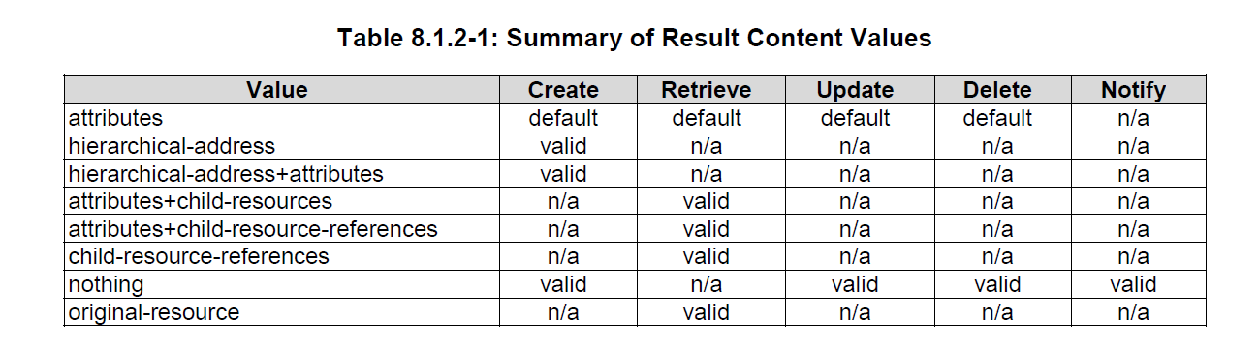
TS 1

Slide 2
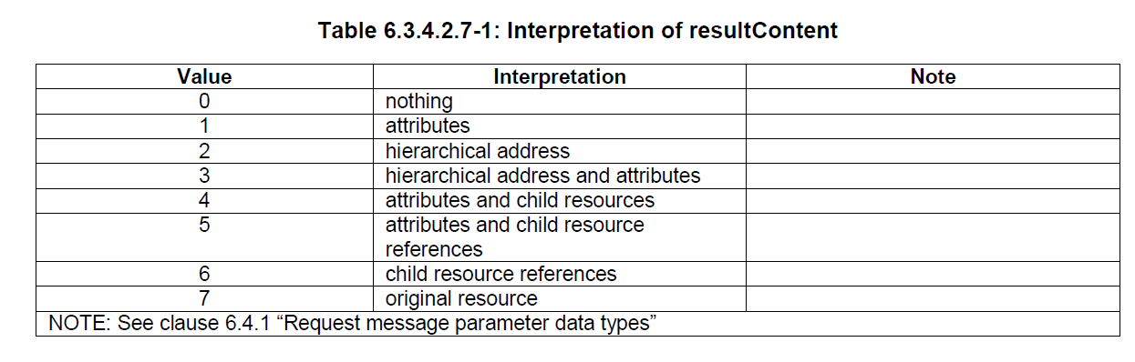
TS4

Slide 3
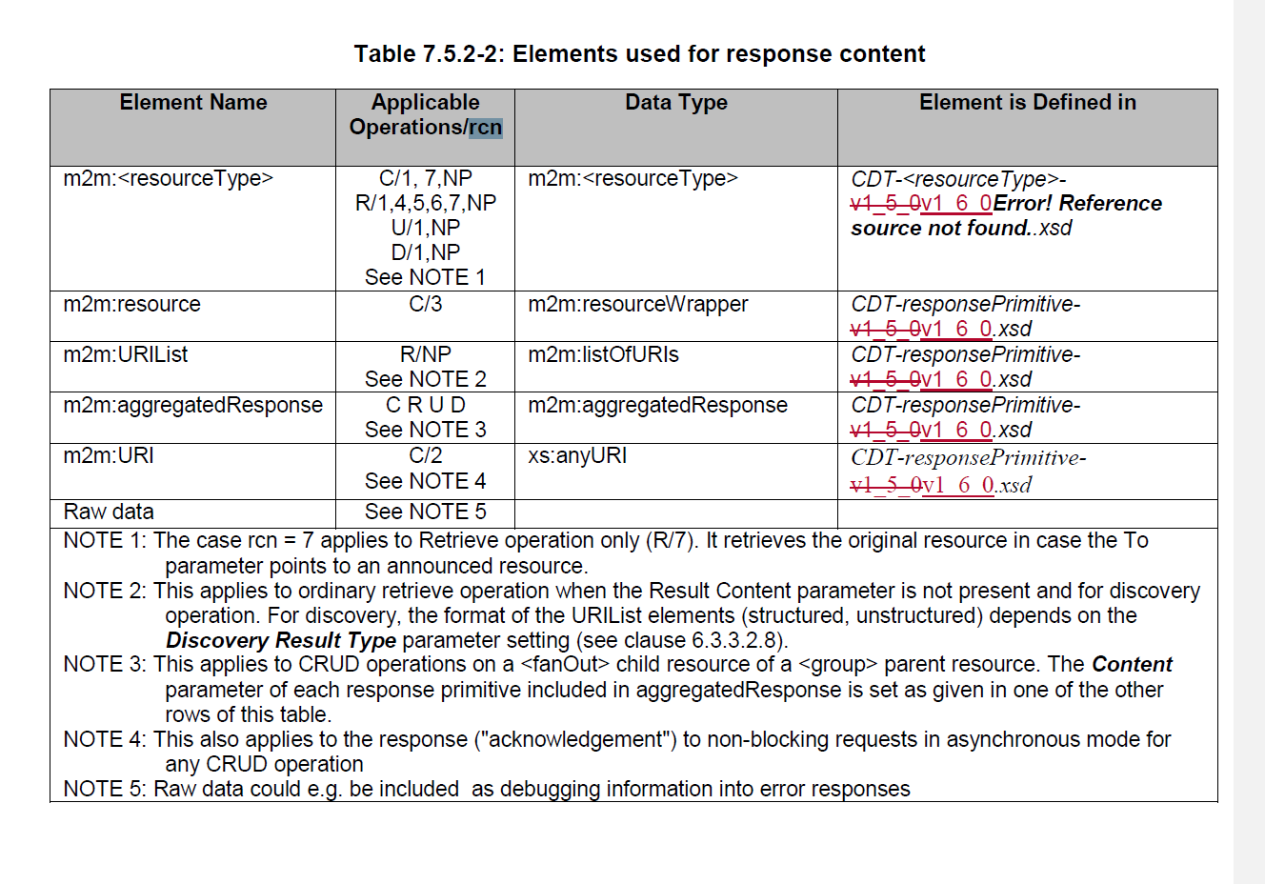
TS 4

Slide 4
fu | rcn |  | Element Name | C | R | U | D | 지원여부
X | 0 | nothing |  | O | X | O | O | YES
 | 1 | attribute (default, NP) | m2m:<resourceType> | O | O | O | O | YES
 | 2 | hierarchical address | m2m:URI | O | X | X | X
 | 3 | hierarchical address and attributes | m2m:resource | O | X | X | X
 | 4 | attributes and child resources |  | X | O | X | X
 | 5 | attributes and child resource references |  | X | O | X | X
 | 6 | child resource references |  | X | O | X | X
 | 7 | original resource |  | X | O | X | X
1 | 0 | nothing |  | X | X | X | X
 | 1 | attribute (default, NP) | m2m:URIList | X | X | X | X
 | 2 | hierarchical address |  | X | X | X | X
 | 3 | hierarchical address and attributes |  | X | X | X | X
 | 4 | attributes and child resources (nesting) |  | X | X | X | X
 | 5 | attributes and child resource references |  | X | X | X | X
 | 6 | child resource references |  | X | X | X | X
 | 7 | original resource |  | X | X | X | X

